Slide 1
41183 PRIVACY PRESERVING
Lecture 7. Web Browsing Privacy

Slide 2
Assignment 1
Due on this Friday, September 12, 2025.
2- 3 members in a group
Only one submission to Canvas
Please include the membership information (student number, name) on the cover page.
In general, the members will obtain the same marks if there is no complaints.

Slide 3
Outline
Background
Web log, traffic analysis attack
https protocol for privacy
Packet Padding
Anonymous communication

Slide 4
Background
The mainstream privacy attacks in web browsing
Which website you browsed
Your browsing traffic could be monitored at your local area network
Traffic analysis attack

Slide 5
Web Server Log
A web server log is a text document that contains a record of all activity related to a specific web server over a defined period of time.
The web server gathers data automatically and constantly to provide administrators with insight into how and when a server is used, as well as the users that correspond with that activity.
Server log content and values
The device’s IP address
Request method
Date and time of the request
Status of the request
Referrer method
User-Agent
Requested file information, including file name, size and network location

Slide 6

Client End Traffic Monitoring
All the traffic of a user could be monitored at the LAN （Local Area Networks）e.g. using Wireshark, a packet sniffer and analysis tool.
An attacker can see everything of your IPv4 packets as they are NOT encrypted

Slide 7
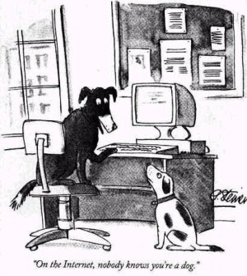
HTTPS protocol
Https protocol adds a security layer on top of the popular http protocol
Asymmetric encryption is applied for a web browser and a web server
The communication is encrypted through https protocol.
We have an authentication problem

Slide 8



Public Key Infrastructure
Key generation service
Certificate service
Client
Web server

Slide 9
Traffic Analysis Attacks
Attacks on encrypted traffic
Attackers possess some background knowledge
Encryption cannot remove the “fingerprints” of web pages.
Web page “fingerprint”
Number of images
Size of each images
Size of the text

Slide 10
Counter Traffic Analysis Attacks
Make every page has the same “fingerprint”
Shannon: perfect secrecy theorem (1950)
Implementation
Dummy packet padding
Disadvantage: too expensive (too many dummy packets needed), waste bandwidth, etc.

Slide 11
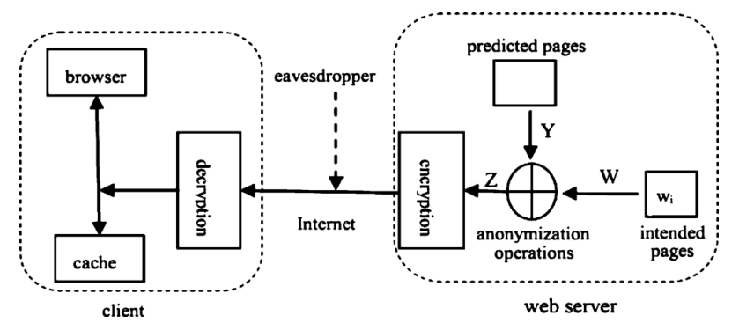
Counter Traffic Analysis Attacks
Predicted packet padding (refer to the reading material of week 7 for details)
- Using the predicted pages (the pages will be accessed by prediction) for padding

Slide 12
Anonymous Communication (Hide the ID)
People want privacy in various scenarios
Web browsing
Online shopping
Whistle blowing
E-voting
…

Slide 13
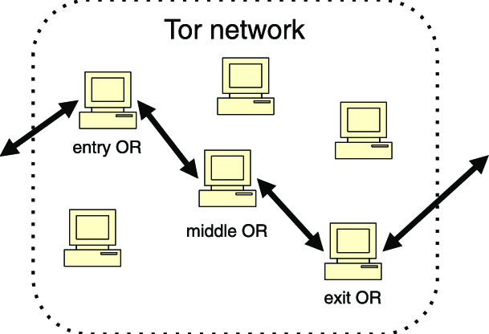
Anonymous Communication
TOR
Disadvantage : Performance
Heavily depend on encryption and decryption

Slide 14
Shuffle Model
Lightly “encrypted” for information aggregation
add random noise between –t and +t for each client, the noise will cancel each other in the final aggregation
Organize pairs to cancel each other in the aggregation. E.g., m1 + X and m2- X for the pair client 1 and 2

